Slide 1
Everlasting Anonymous Rate-Limited Tokens
Rutchathon (Champ) Chairattana-Apirom (University of Washington)
Nico Döttling (CISPA)
Anna Lysyanskaya (Brown University)
Stefano Tessaro (University of Washington)

Slide 2





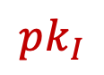
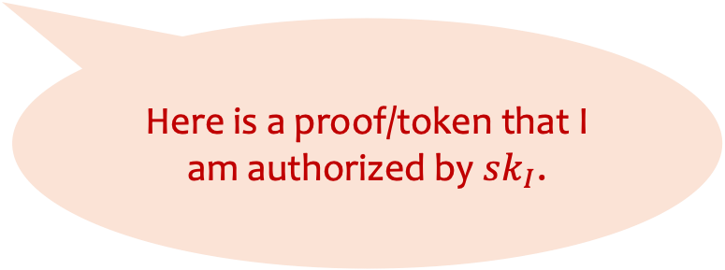
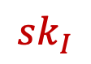
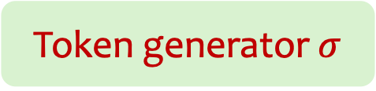
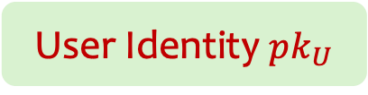
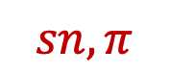
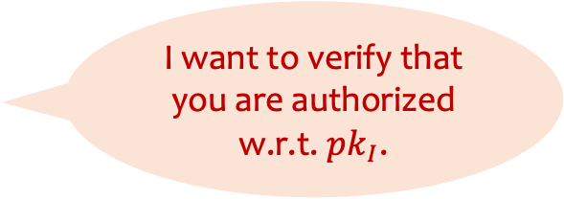
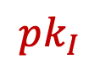
Anonymous Tokens
Issuer
Verifier
I want to verify that you are authorized w.r.t. $pk_{I}$.
$$sk_{I}$$
$$pk_{I}$$
Anonymity: Even if issuer and verifier collude, cannot link/track the user.
$$sn, π$$
Here is a proof/token that I am authorized by $sk_{I}$.
User Identity $pk_{U}$
User
$$pk_{I}$$
Token generator $σ$
Notes:
First, let me introduce the settings of anonymous tokens.
Here we have an issuer, user, verifier. The issuer has their own secret and public keys. We denote the user identity with some pk_U
Here, user and issuer interacts so that the user receives a token / token dispenser bound to the user identity. (Make it clear that token generator -- )
Say the user wants to access some service provided by the verifier. The verifier might ask the users to authenticate that they are authorized by the issuer. The user then generates a token (which also contains a serial number) and send them to the verifier.
We also require anonymity to hold, meaning even if the issuer and verifier collude, they cannot track/link the user’s activity.
An example of this primitive is the Privacy pass protocol which is used to bypass captchas in browsers.

Slide 3
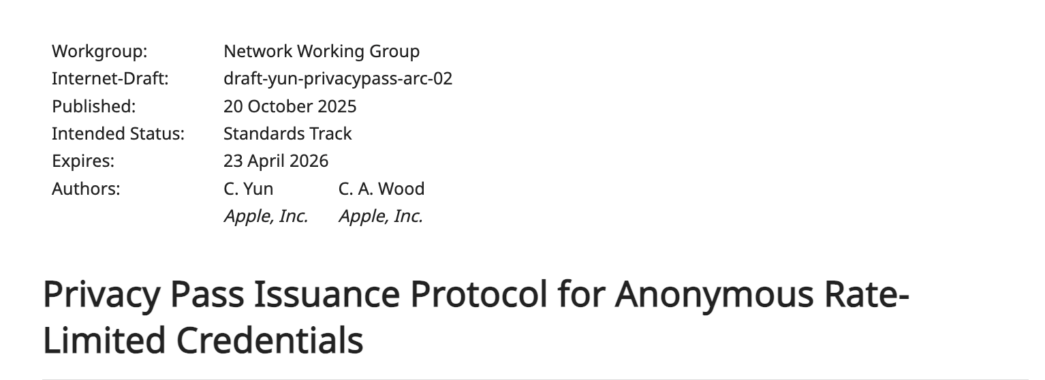
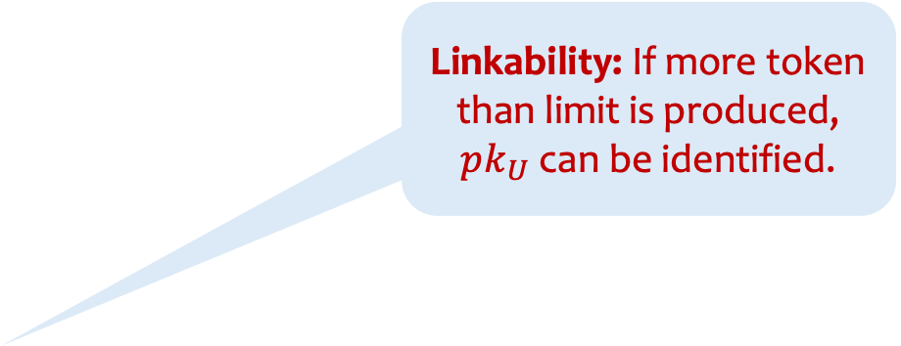
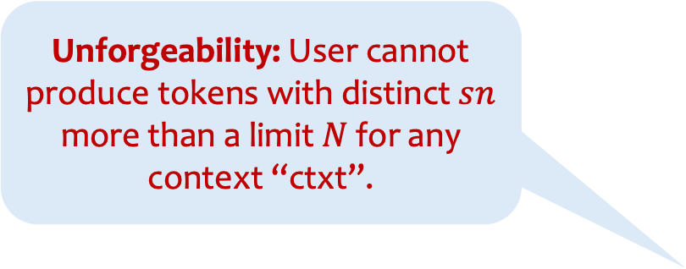

Rate-Limitation
Verifier
Issuer
ctxt = ‘blahblah.com’||date
$$sk_{I}$$
$$pk_{I}$$
Linkability: If more token than limit is produced, $pk_{U}$ can be identified.
Unforgeability: User cannot produce tokens with distinct $sn$ more than a limit $N$ for any context “ctxt”.
$$sn, π$$
Want some “rate-limiting” properties based on some “contexts”.
User Identity $pk_{U}$
User
$$pk_{I}$$
Token generator $σ$
Notes:
In some case, one might want to rate-limit the tokens: so that they can be used for specific context for a limited number of times.
For Example: accessing website but for limited time per day or something
The required security properties are unforgeability which says that (read out) and linkability which says that (read out)
We note that the rate-limited primitives such as credentials are being standardized in the IETF
(Move things a bit closer--maybe out of bounds?)

Slide 4
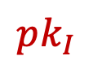

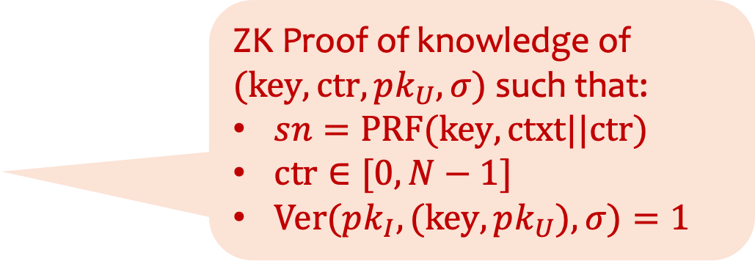
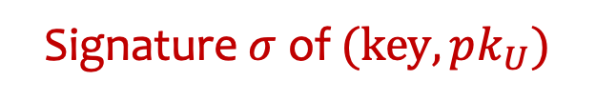
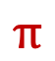
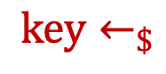
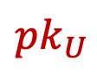
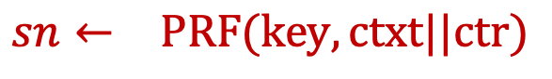
Prior Constructions [CHL’05, CHKLM’06]
Issuer
User
$$sk_{I}$$
$$pk_{I}$$
$$key←_{\$}$$
$$pk_{U}$$
Signature $σ$ of $(key,pk_{U})$
Verifier
Only computationally anonymous
ZK Proof of knowledge of
$(key,ctr,pk_{U},σ)$ such that:
$sn=PRF(key, ctxt||ctr)$
$ctr∈[0,N−1]$
$Ver(pk_{I},(key,pk_{U}),σ)=1$
ctxt = ‘blahblah.com’
$$sn←_{}PRF(key, ctxt||ctr)$$
$$π$$
Notes:
One particular way to achieve this property as shown in the e-cash protocol by Camenisch Hohenberger and Lysyanskaya is as follows:
In the issuance phase, the user samples a PRF key and interacts in a protocol where it receives a signature of the key and its identity.
To produce tokens, it computes the “serial number” by evaluating the PRF on ctxt || counter. Along with a proof of knowledge of the (prf key, coutner, pk_U, signature) that (1) serial number is computed correctly, (2) coutner is bounded by the rate-limit N, (3) signature is valid for key, pk_U w.r.t. issuer’s key.
I note that this construction however only achieves computational anonymity due to sn computationally indist from random. (Saying out loud why this is unforgeability -- counter is bounded... Domain of PRF...) (SMARK + AES) (lattice) or (group-based but comp)

Slide 5

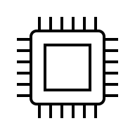

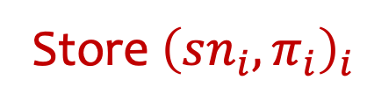
Post-Quantum Anonymity vs Unforgeability
Adversary
User
Adversary
Store ${\left(sn_{i},π_{i}\right)}_{i}$
De-anonymize past actions even after transitioning to PQ
After transition to PQ, we are fine.
Quantum
Computer
Quantum
Computer

Slide 6
Achieving Post-quantum Anonymity
Full-on post-quantum scheme (e.g., lattice-based)
Still quite inefficient

Slide 7
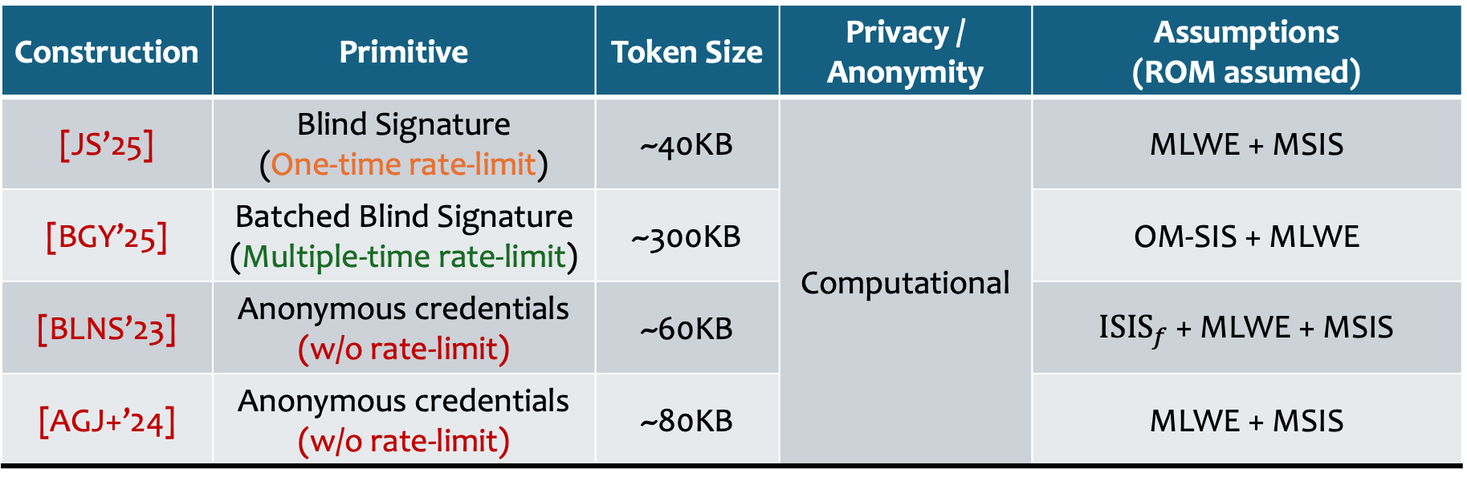
Lattice-Based Constructions of similar primitives
Construction | Primitive | Token Size | Privacy / Anonymity | Assumptions (ROM assumed)
[JS’25] | Blind Signature (One-time rate-limit) | ~40KB | Computational | MLWE + MSIS
[BGY’25] | Batched Blind Signature (Multiple-time rate-limit) | ~300KB |  | OM-SIS + MLWE
[BLNS’23] | Anonymous credentials (w/o rate-limit) | ~60KB |  | $ISIS_{f}$ + MLWE + MSIS
[AGJ+’24] | Anonymous credentials (w/o rate-limit) | ~80KB |  | MLWE + MSIS
Notes:
Here is also some token size comparison with lattice-based constructions of similar primitives
Compared to blind signatures which are one-time rate-limiting: our token size is slightly smaller
To Batched blind signatures (which give similar guarantee to us without “context-based” rate-limiting), our sizes are much smaller.
Compared to anonymous credentials (without rate-limitation), we also have smaller sizes.

Slide 8
Achieving Post-quantum Anonymity
Full-on post-quantum scheme
Still quite inefficient
Using a lattice-based PRF + group-based primitive
Proving correct PRF evaluation is expensive
Mixing assumptions, e.g., LWE + group-based
This work: what if we go further?
Group-based construction
Statistical / Everlasting Anonymity
Somewhat efficient

Slide 9
Our Results
Pairing-based anonymous tokens construction with
Everlasting Anonymity
Unforgeability & Linkability from q-Type assumption + SXDH + ROM
Token generation time is independent of total number of tokens available per each token dispenser
Notes:
Our results is as follows:
We give a pairing-based construction with everlasting anonymity guarantee. Our unforgeability and linkability is based on q-type assumption + DDH + random oracle
Token generation time is independent of the bound on number of tokens per dispenser.

Slide 10
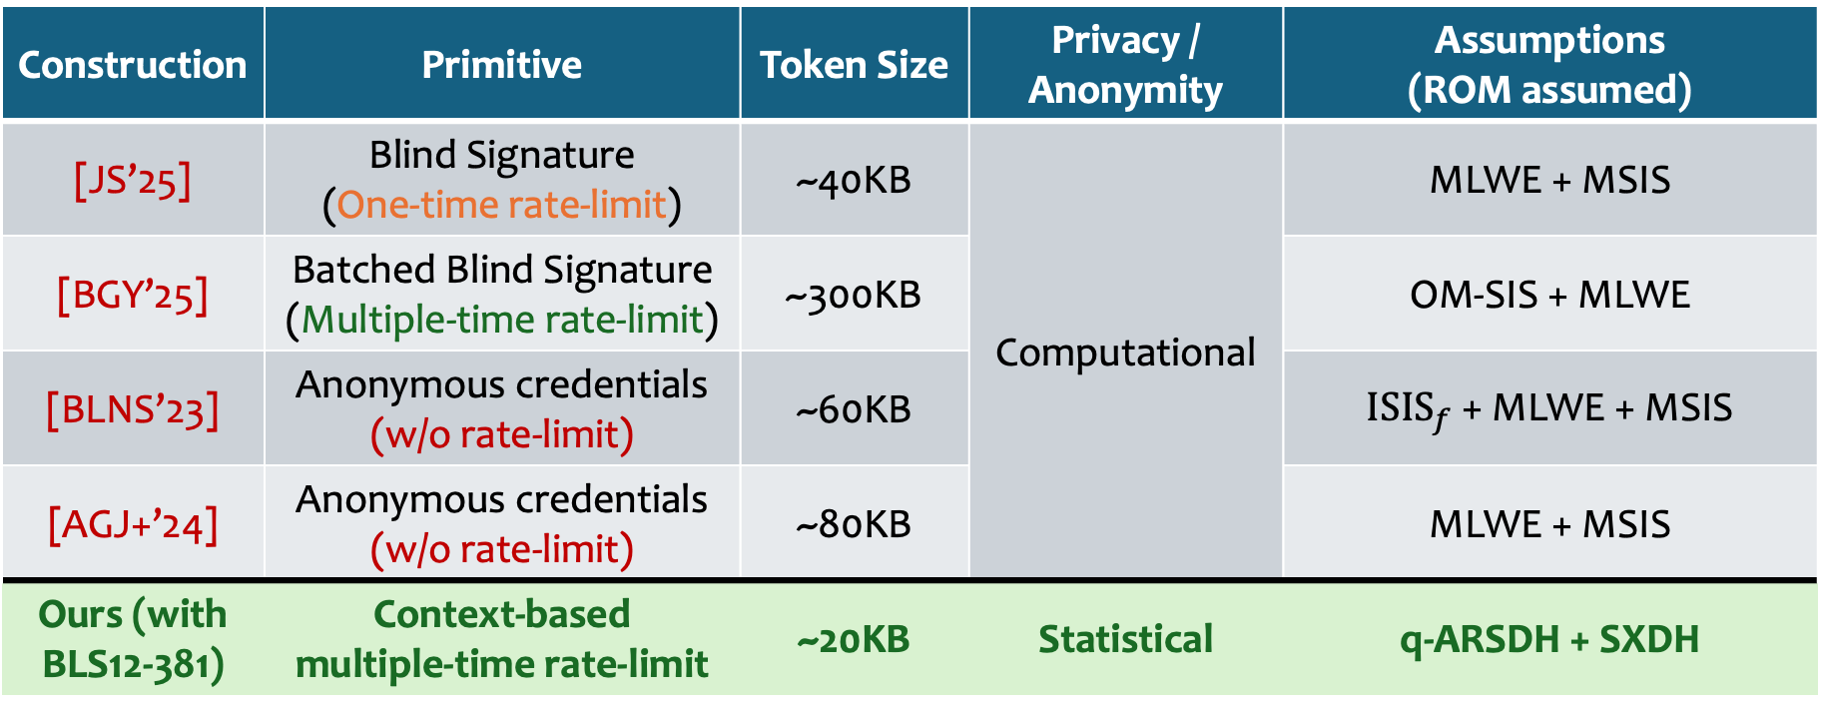
Comparison with Lattice-Based Constructions of similar primitives
Construction | Primitive | Token Size | Privacy / Anonymity | Assumptions (ROM assumed)
[JS’25] | Blind Signature (One-time rate-limit) | ~40KB | Computational | MLWE + MSIS
[BGY’25] | Batched Blind Signature (Multiple-time rate-limit) | ~300KB |  | OM-SIS + MLWE
[BLNS’23] | Anonymous credentials (w/o rate-limit) | ~60KB |  | $ISIS_{f}$ + MLWE + MSIS
[AGJ+’24] | Anonymous credentials (w/o rate-limit) | ~80KB |  | MLWE + MSIS
Ours (with BLS12-381) | Context-based multiple-time rate-limit | ~20KB | Statistical | q-ARSDH + SXDH
Notes:
Here is also some token size comparison with lattice-based constructions of similar primitives
Compared to blind signatures which are one-time rate-limiting: our token size is slightly smaller
To Batched blind signatures (which give similar guarantee to us without “context-based” rate-limiting), our sizes are much smaller.
Compared to anonymous credentials (without rate-limitation), we also have smaller sizes.

Slide 11
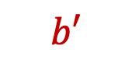
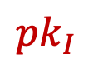
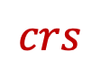
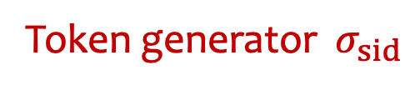
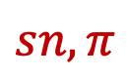
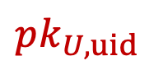

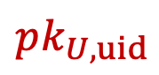
Definition of (Everlasting) Anonymity
$$pk_{U,uid}$$
NewUsr
Possibly malicious key
User
Real user or simulator
uid
$$pk_{U,uid}$$
sid, uid
$$crs$$
Token generator $σ_{sid}$
$$pk_{I}$$
sid,ctxt
Show
Real user or simulator
$$sn, π$$
Wins if guess correctly whether real or simulated
$$b′$$
Adversary $𝒜$
Notes:
Here is how we define everlasting anonymity (pretty hard to follow -- computational (version))
Not easy to follow. (power of the simulator) (Rationalize how we come up with it.) *** Spell out the real user, Show will use the token generator. (Merge with the next slide.)
(k how large? )
1. We have unbounded adversary acting as the issuer
2. it is given a CRS and can pick a malicious public key
3. A’s goal is to guess which world (real, simulated) it is in correctly. To do so, it has access to the following oracles
4. It has access to a user oracle either interacting with a real or simulated user
5. Then, it has access to a show oracle where it can ask the user to produce tokens based on a specified context (again either real or simulated).
Note that the simulator in this case would not know the user's public key nor keep any state.
6. There is some restriction on this oracle in that the adv cannot query more that the rate-limit per context nor exceed some overall limit k per token dispenser.

Slide 12
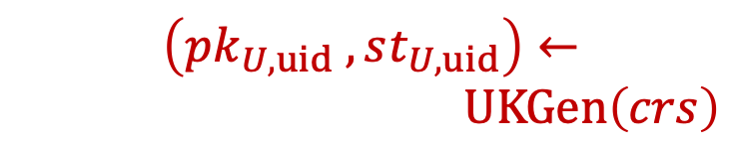
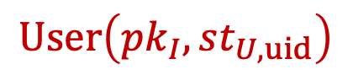
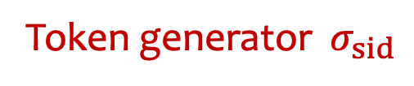
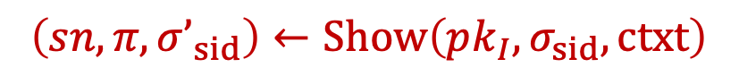
Anonymity: Real World
$$\left(pk_{U,uid} ,st_{U,uid}\right)←$$
$UKGen\left(crs\right)$
NewUsr
User
$$User\left(pk_{I},st_{U,uid}\right)$$
uid
$$pk_{U,uid}$$
sid, uid
Token generator $σ_{sid}$
$$crs$$
$$pk_{I}$$
sid,ctxt
Show
$$sn, π$$
Wins if guess correctly whether real or simulated
$$b′$$
Adversary $𝒜$
$$\left(sn,π,σ’_{sid}\right)←Show\left(pk_{I},σ_{sid},ctxt\right)$$
Notes:
Here is how we define everlasting anonymity (pretty hard to follow -- computational (version))
Not easy to follow. (power of the simulator) (Rationalize how we come up with it.) *** Spell out the real user, Show will use the token generator. (Merge with the next slide.)
(k how large? )
1. We have unbounded adversary acting as the issuer
2. it is given a CRS and can pick a malicious public key
3. A’s goal is to guess which world (real, simulated) it is in correctly. To do so, it has access to the following oracles
4. It has access to a user oracle either interacting with a real or simulated user
5. Then, it has access to a show oracle where it can ask the user to produce tokens based on a specified context (again either real or simulated).
Note that the simulator in this case would not know the user's public key nor keep any state.
6. There is some restriction on this oracle in that the adv cannot query more that the rate-limit per context nor exceed some overall limit k per token dispenser.

Slide 13
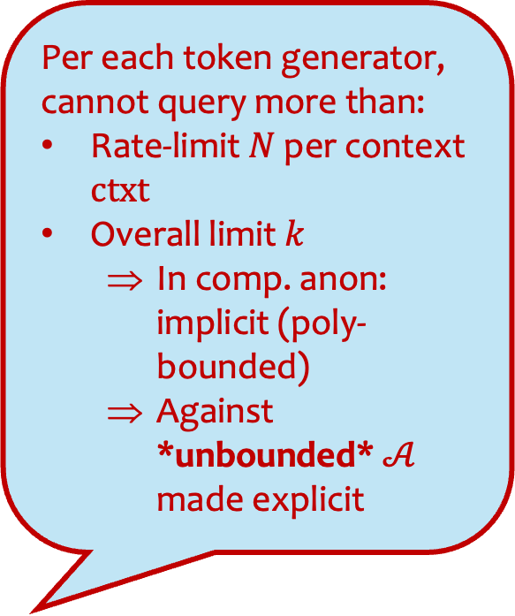
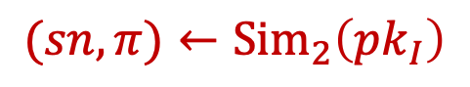
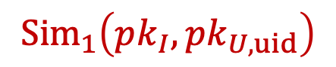
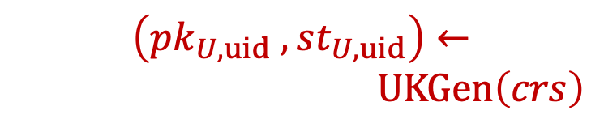
Anonymity: Ideal World
Per each token generator, cannot query more than:
Rate-limit $N$ per context $ctxt$
Overall limit $k$
In comp. anon: implicit (poly-bounded)
Against *unbounded* $𝒜$ made explicit
$$\left(pk_{U,uid} ,st_{U,uid}\right)←$$
$UKGen\left(crs\right)$
NewUsr
$$Sim_{1}\left(pk_{I},pk_{U,uid}\right)$$
User
uid
$$pk_{U,uid}$$
sid, uid
$$crs$$
$$pk_{I}$$
sid,ctxt
Show
$$sn, π$$
Wins if guess correctly whether real or simulated
$$b′$$
Adversary $𝒜$
$$(sn,π)←Sim_{2}\left(pk_{I}\right)$$
Notes:
Here is how we define everlasting anonymity (pretty hard to follow -- computational (version))
Not easy to follow. (power of the simulator) (Rationalize how we come up with it.) *** Spell out the real user, Show will use the token generator. (Merge with the next slide.)
(k how large? )
1. We have unbounded adversary acting as the issuer
2. it is given a CRS and can pick a malicious public key
3. A’s goal is to guess which world (real, simulated) it is in correctly. To do so, it has access to the following oracles
4. It has access to a user oracle either interacting with a real or simulated user
5. Then, it has access to a show oracle where it can ask the user to produce tokens based on a specified context (again either real or simulated).
Note that the simulator in this case would not know the user's public key nor keep any state.
6. There is some restriction on this oracle in that the adv cannot query more that the rate-limit per context nor exceed some overall limit k per token dispenser.

Slide 14

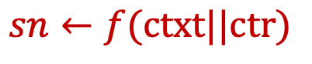
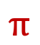
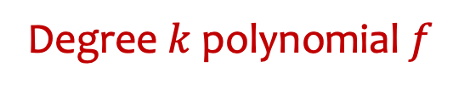
Strawman Solution: Random Degree-k Polynomial
Issuer
User
$$sk_{I}$$
$$pk_{I}$$
$$key←_{\$}$$
$$pk_{U}$$
Signature $σ$ of $(key,pk_{U})$
Verifier
Only computationally anonymous
Degree $k$ polynomial $f$
ctxt = ‘blahblah.com’
$$sn←_{}PRF(key, ctxt||ctr)$$
$$sn←f(ctxt||ctr)$$
$$π$$
Notes:
Now, to achieve everlasting anonymity, we first try to replace the PRF with a k-wise independent function, e.g., random degree-k polynomial. The key idea here is to ensure that the serial numbers will look random for at most k tokens.

Slide 15
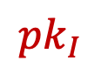
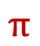
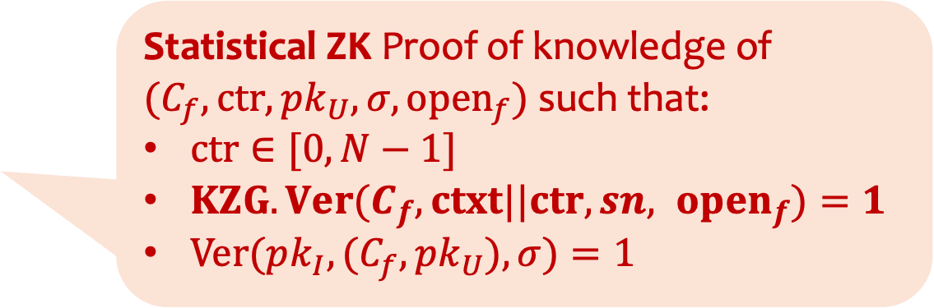
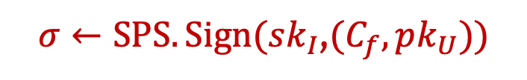
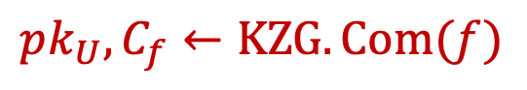
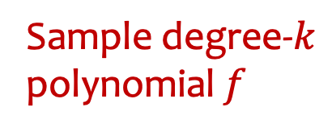
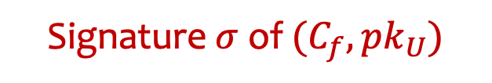
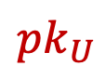
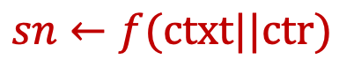
Everlasting Anonymity via (1) k-wise independence of the polynomial, (2) statistical hiding of KZG commitment, and (3) statistical ZK.
Structure-preserving signatures (SPS) signing group elements
[KZG’10] Polynomial commitment
Issuer
User
$$pk_{U},C_{f}←KZG.Com(f)$$
$$sk_{I}$$
Sample degree-$k$ polynomial $f$
$$pk_{I}$$
$$pk_{U}$$
$σ←SPS.Sign(sk_{I}$,$(C_{f},pk_{U}))$
Signature $σ$ of $(C_{f},pk_{U})$
Verifier
Statistical ZK Proof of knowledge of
$(C_{f},ctr,pk_{U},σ,open_{f})$ such that:
$ctr∈[0,N−1]$
$KZG.Ver(C_{f}, ctxt||ctr,sn, open_{f})=1$
$Ver(pk_{I},(C_{f},pk_{U}),σ)=1$
ctxt = ‘blahblah.com’
$$sn←f(ctxt||ctr)$$
$$π$$
Notes:
Fleshing this out, the user first sample the polynomial.
1. commit to it using a KZG commitment
2. Sign using structure preserving signatures (which signs group elements).
3. Using the signature we can produce the following proof of knowledge which proves similar relation to before, except that instead of proving that the computation of f is done correctly, we prove that the user “knows” a corresponding evaluation opening to the signed commitment instead.
4. Note that here we achieve anonymity through k-wise independence, statistical hiding of KZG commitment, and statistical ZK.
(Mention Groth-Sahai for the pairing-product equations check)

Slide 16
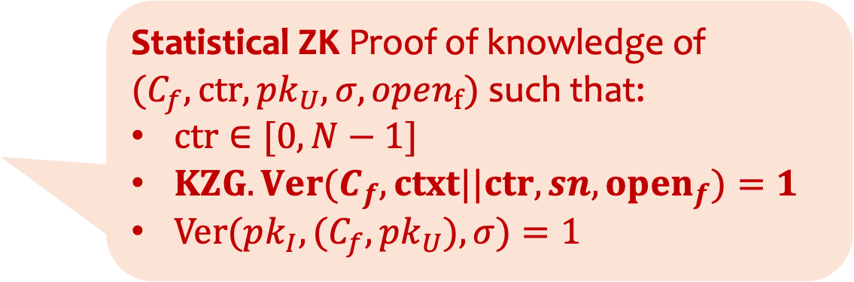


Structure-preserving signatures (SPS) signing group elements
[KZG’10] Polynomial commitment scheme
Downside: Running time scales linearly with $k$ per each token generation!
Issuer
Sample degree-$k$ polynomial $f$
User
$$pk_{U},C_{f}←KZG.Com(f)$$
$$sk_{I}$$
$$pk_{I}$$
$$pk_{U}$$
$σ←SPS.Sign(sk_{I}$,$(C_{f},pk_{U}))$
Signature $σ$ of $(C_{f},pk_{U})$
Verifier
Statistical ZK Proof of knowledge of
$(C_{f},ctr,pk_{U},σ,open_{f})$ such that:
$ctr∈[0,N−1]$
$KZG.Ver(C_{f}, ctxt||ctr,sn,open_{f})=1$
$Ver(pk_{I},(C_{f},pk_{U}),σ)=1$
ctxt = ‘blahblah.com’
$$sn←f(ctxt||ctr)$$
$$π$$
Notes:
The downside of this construction, however, is that computing the serial number and opening now runs in time linear in this bound k “per each token generation”

Slide 17
Our approach at a high-level
Replace a random polynomial with (almost) k-wise independent function with fast evaluation [Pagh-Pagh’08,BHNK’18]
Still commit to function keys with KZG commitments and sign with SPS
Structure of the keys allow some preprocessing of the openings
Notes:
To fix this, we do the following.
We replace the polynomial with (almost) k-wise independent function with fast evaluation (make it clear that this is not defined yet, will mention next slide) -- Change naming?
Still commit to function keys with KZG commitments, but due to the structure of the function keys, some openings can be precomputed, allowing for faster token generation time.
Proof of knowledge is similar to before that showing knowledge of valid commitment and signatures, valid openings, and that these valid openings correspond to the correct evaluation of the function.

Slide 18














Statistically Pseudorandom Function with faster evaluation [Pagh-Pagh’08,BHNK’18]
$$input∈𝒟$$
$f_{1},f_{2},g:$ $Θ(λ)$-degree polynomials
$T_{1},T_{2}:$ Random tables with entries in $ℛ$ of size $Θ(k)$
$$f_{1}$$
$$f_{2}$$
$$g$$
Assuming RAM Model: (1) $f_{1},f_{2},g$ low-deg => $Θ(λ)$ time (2) look-up is $Θ(1)$
$$T_{1}$$
$$T_{2}$$
$$T_{2}\left[f_{2}\left(input\right)\right]$$
Thm [PP’08, BHNK’18]. Pseudorandomness against unbounded adversaries with $≤k$ adaptive queries
$$g\left(input\right)$$
$$T_{1}\left[f_{1}\left(input\right)\right]$$
$$output∈ℛ$$
Notes:
(A bit fast... on this slide...)
(Trimming down things--O(\lambda) degrees)
To give some idea on how the function works,
1. We have the input fed to three functions f1, f2, g
2. Then, the output of f1, f2 are used as an index to large look-up tables T1 T2.
3. Finally, the output of g and these table entries are summed together to the output
Note that in this construction, f1, f2, g are only security-parameter -wise independent functions and T1, T2 are random tables of size linear in k. Assuming that one can lookup the tables in constant time, the running time now only relates to computing f1,f2, g and doing the lookups. (in the RAM model).
It is already known that this construction satisfies "pseudorandomness" against unbounded adveraries with at most k adaptive query to evaluation oracle. (Pseudorandom against ... w/o evaluation oracle... )

Slide 19








Modifications amenable to group-based techniques
$f_{1},f_{2},g:$ $Θ(λ)$-degree $ℤ_{p}$-polynomials.
Committed to using KZG
Compute openings in time $Θ(λ)$
$$input∈ℤ_{p}$$
Proved via Inner-Product Argument (e.g., bulletproof)
$$f_{1}$$
$$f_{2}$$
$$g$$
$$mod m$$
$$mod m$$
$$T_{1}$$
$$T_{2}$$
$T_{1},T_{2}:$ Random tables $ℤ_{p}^{m}$ with $m=Θ(k)$.
KZG commit to polynomial $t_{i}\left(j\right)=T_{i}\left[j\right]$ for $j∈\left[m\right], i=1,2$.
Precompute openings in time $\tilde{O}\left(m\right)$ [GHO20,FK23]
$$T_{2}\left[f_{2}\left(input\right) mod m\right]$$
$$g\left(input\right)$$
$$T_{1}\left[f_{1}\left(input\right) mod m\right]$$
$$output∈ℤ_{p}$$
Notes:
To make the construction work with group-based techniques, we made some small modifications.
1. Domain and range are now Zp. f1, f2, g are Zp-polynomials. They will be committed to via KZG. Evaluating and computing will be in time O(\lambda)
2. The outputs of f1, f2 are modded down to the range [0, m-1] and used as indices to T1 T2.
3. These two tables are also committed to via KZG by committing to the polynomial which evaluates on each index to the corresponding entry. Note that since we know in advance where the openings are going to be, we can precompute these openings.
The modulo computation are more complicated but can be proved via inner-product argument with similar complexity to the range proof that was already used to prove validity of the counter.
(Trim words, inner product arguments, )

Slide 20


Summary
Asymptotic efficiencies in $k≫N$ (e.g., $k=2^{20},$ $N=2^{10}$)
Omitted properties:
Linkability: Double-spender can be identified
Exculpability: Malicious users (even when colluding with issuer) cannot frame honest users of double spending
Construction | Runtime |  |  | Size (in group elements & scalars)
 | U @ Issuance | Issuer | User @ Token | Dispenser | Token
Strawman | $$k⋅poly\left(λ\right)$$ | $$poly\left(λ\right)$$ | $$k⋅poly\left(λ\right)$$ | $$O\left(k\right)$$ | $$O\left(\log{\log{N}}\right)$$
Ours | $$k\log^{2}{k}⋅poly\left(λ\right)$$ | $$poly\left(λ\right)$$ | $$log⁡N⋅poly\left(λ\right)$$ | $$O\left(k\right)$$ | $$O\left(\log{λ}\right)$$
❌
✅
Notes:
Now, just to give a summary.
- We improve from the strawman construction by eliminating the dependency on k per each token generation
- This is paid by larger token sizes and slightly larger user time at issuance
- In this talk, I omitted how we achieve other properties such as linkability and exculpability. The latter ensures that no malicious users can frame honest users for double spending.
(Put a check/symbol and cross)
(black and red is generally bad)
(More on what I expect k to be , N to be) k >> N

Slide 21
Future Directions
Can we get a more efficient construction?
Using stronger models (AGM or GGM)?
Shorter proofs but more computation overhead, e.g., Plonk?
Avoiding structure-preserving signatures?
Implementations?
Best-of-both-worlds: Everlasting anonymity + Post-Quantum unforgeability?
Thank you!! Please check out ePrint: 2025/1030
Notes:
Feedback:
- For everlasting anonymity (too quick)
- Wording of the last part: Lattice-based token construction with everlasting anonymity
- (Best of both worlds)
- Reduce texts
- Strawman construction... (What is a token dispenser, Why you get unforgeability, )

